Slide 1
Data Mining DS-303
Lecture 5
Muhammad Arham
Lecturer
The University of Faisalabad

Slide 2
Content
Web & Social Network Mining

Slide 3
Web Mining

Slide 4
What is Web Mining?
Web Mining is the use of the data mining techniques to automatically discover and extract information from web.
Web mining can find interesting and potentially useful knowledge from web data.

Slide 5
What is Data Mining?
Data mining or knowledge discovery from data is the process of analyzing data from different perspectives and summarizing it into useful information
Knowledge discovery in database
Raw data knowledge

Slide 6
Data Mining Techniques
The most popular data mining techniques are
Clustering
Classification
Association Rules
Correlation
Naïve Bayesian
Neural Networks
Outlier detection/ Anomaly detection
Regression
Logistic Regression

Slide 7
What is Web Data?
Web content- text, image, records, etc.
Web structure- hyperlinks, tags etc.
Web usage- http log, app server logs, etc
Intra-page structure – document level
Inter-page structure – hyperlink level
Supplemental data
Profiles
Registration information
Cookies

Slide 8
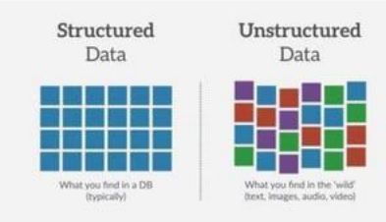
Data Mining vs. Web Mining
Data Mining
Data is structured and relational
Well-defined tables, columns, rows, keys, and constraints.
Web Mining
Semi-structure (HTML) and unstructured

Slide 9
Example: Assessing credit; risk
Situation: Person applies for a loan
Task: Should a bank approve the loan?
Note: People who have the best credit don’t need the loans, and people with worst credit are not likely to repay.
Bank’s best customers are in the middle.

Slide 10
Example: Insurance Fraud
Insurance fraud is the filing of a false claim to life, health, automobile, property or other type of insurance benefits.
Insurance companies lose millions of dollars each year through fraudulent claims, largely because they do not have a way to easily determine which claims are legitimate and which may be fraudulent.
Data mining enables insurance companies to predict which insurance claims are likely to be fraudulent.

Slide 11
Opportunities and Challenges
The amount of information on the web is huge.
The coverage of web information is very wide and diverse. One can find information about almost anything. Information/data of almost all types exist on the web. For example, structured tables, texts, stream data etc.
Much of the web information is semi-structured due to the nested structure of HTML code.
Much of the web information is linked. There are hyperlinks among pages within a site, and across different sites.
Much of the web information is redundant. The same piece of information or its variants may appear in many pages.

Slide 12
Opportunities and Challenges
The web is noisy. A webpage generally contains a mixture of many kinds of information. For example: main contents, advertisements, navigation panels, copyright notices, etc.
The web is dynamic. New pages are constantly being generated. Keeping up with the changes and monitoring the changes are important issues.
Above all, the web is virtual society. It is not only about data, information and services, but also about interaction among people, organization and automatic systems and communities.

Slide 13
Application of Web Mining in E-commerce
Customer analyzing
Mined data help acquire new, retain existing customers, improvement of merchant services and profit by predicting customer online purchase behavior
What do the customer do?
What do the customer want?
How effectively use the web data to market products and to service the customer?
Whether customers are purposefully or just browsing?
Buying something they are familiar with or something they know little about?
Are they shopping from home, from work or from a hotel?

Slide 14
Application of Web Mining in E-commerce
Web Personalization
According to the information from user behavior, a website can be designed and re-structured to make it more advance and user-friendly. In addition, the image and product value of the company is very important in satisfying customer need based on website quality.
Personalizing a website involves tailoring content based on the characteristics of each individual user’s online behaviors.
Personalized content is often determined by user behaviors such as pages views, buttons clicks and forms submitted.

Slide 15
Application of Web Mining in E-commerce
Product Search & Recommendation
When the user searched for a product how we find the best results for the users?
Typically, a user query of a few keywords can match many products
Through large-scale data analysis of query logs, we can create graphs between queries and products, and between different products.
For example, the user who searches for “Verizon cell phones” might click on the Sumsung SCJ U940 Glyde product and the the LG VX10000 Voyager. We now know the query is related to those two products, and thee two products have a relationship to each other since a user views (and perhaps considered buying) both.

Slide 16
Categories of Web Mining
Web mining is divide into three categories
Web content mining
Web usage mining
Web structure mining

Slide 17
Web Content Mining
To gather, categorize, organize and provide the best possible information available on the web to the user requesting the information.
The data may be unstructured or structured (data from a database) or semi-structured (html)
Content mining is the scanning and mining of text, picture, video, audio and graphs of a web page to determined the relevance of the content to the search query.
Content mining provides the results list to search engines in order of highest relevance to the keywords in the query.
Web content mining is related to data mining and text mining.

Slide 18
Text Mining
Text mining is the analysis of data contained in natural language text.
Text mining attempts to drive meaning from the words and sentences in order to classify documents, route messages appropriately, as well as create summaries of content
Unstructured Data Examples: Email, Insurance Claim, Web Pages, Technical Documents, Contract

Slide 19
Data Mining Techniques Using In Web Content Mining
The more basic and popular data mining techniques in web content mining are:
Classification: Placing the documents into predefined set of groups such as science articles, political articles etc.
Clustering: Clustering is a technique used to group similar documents (is not done based on predefined). As a result useful documents will not be omitted from the search results. Clustering helps the user to easily select the topic of interest.
Summarization: It is used to reduce the length of the document by maintaining the main points. An example for text summarization is Microsoft Word’s AutoSummarize
Visualization: Utilization feature extraction and key term indexing to build a graphical representation. Through visualization, document having similarity are found out is useful to find out related topic from a very large amount of documents. Example: Word cloud, Scatter plot, Streamgraph, Tree map, Heat map, Gantt Chart, etc.

Slide 20
Web Usages Mining
Web Usage Mining
Is used to understand the customer behavior
Focuses on the discovering of potential knowledge from browsing patterns of the users.
Can discover the knowledge in the hidden browsing patterns and analyses the visiting characteristics of the users.
The primary data source used in web usage mining is the server log-files (web-logs).
Browsing web pages by the user leaves a lot of information in the log-file.
Analyzing log-files information drives us to understand the behavior of the user
Techniques use for discovering the potential knowledge from the browsing patterns are:
Clustering
Classification
Association rule

Slide 21
The Phase of Web Usage Mining
Web usage mining is a complete process that includes various stages of data mining cycle, including Data Preprocessing, Pattern Discovery and Pattern Analysis.
Initially, at the data preprocessing stage web log is preprocessed to clean, integrate and transform into a common log.
In the pattern discovery: Data mining techniques are applied to discover the interesting characteristics in the hidden patterns.
Pattern analysis is the final stage of web usage mining which can validate interested patterns from the output of pattern discovery that an be used to predict user behavior.

Slide 22
Classification
Classification is the most familiar and most popular data mining techniques for web usage mining.
Data classification is the process of organizing data into categories for its most effective and efficient use.
Classification technique uses to segment and classify observations
Example:
People with age less than 40 and salary more then 40000 trade on line (Demographic segmentation).
Blackberry was launched for users who were business people, sumsung was launched for users who like android and like various applications for free price and apple was launched for the premium customers who want to be a part of a unique and popular niche (behavioral segmentation)

Slide 23
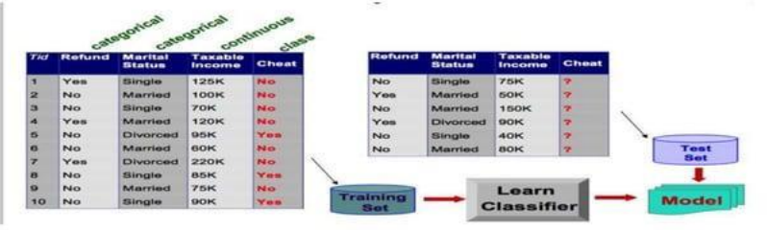
Classification
Classification consist of assigning a class label to a set of unclassified cases.
The goal of classification is to build a model that can be used to predict the class of records whose class label is not know.

Slide 24
Classification Algorithm
The most popular classification algorithm are:
Decision trees
Logistic regression
Neural networks
K-nearest neighbors

Slide 25
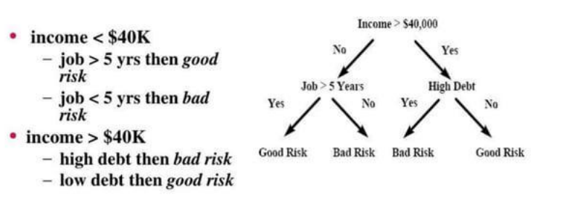
Decision Trees
A decision tree is a graph that uses a branching method to illustrate every possible outcome of a decision
Example

Slide 26
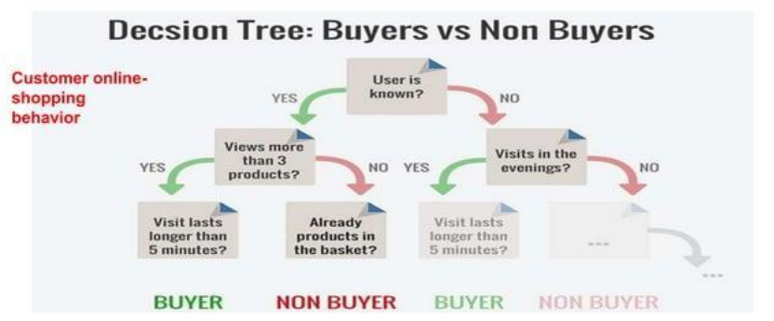
Decision Trees

Slide 27
Decision Tree using Orange Data Mining
Analysing data in Orange using Decision tree.
Select file: Decision tree from Dataset Folder (On Fronter)
Exercise:
Explain the output of the Decision tree

Slide 28
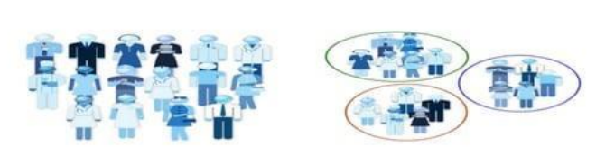
Clustering
Clustering is the process of dividing a dataset into groups such that the members of each group are as similar as possible to one another and different group are as dissimilar as possible from one another.
The most popular distance-based clustering algorithm is ‘k-means’.

Slide 29
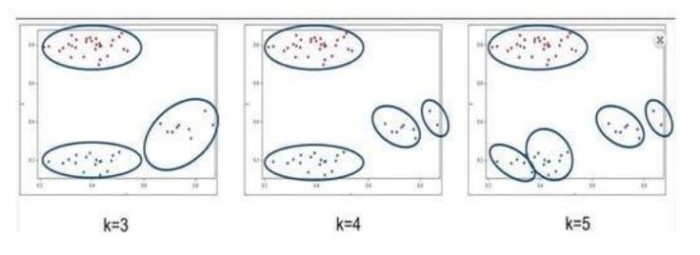
K-Means for Clustering

Slide 30
Clustering Using Orange
Select file: Clustering from dataset folder (On Fronter)
Select K-Means from Unsupervised Widget set.
Select MDC (Multidimensional Scaling)
Unsupervised Widget set
Explain the output of the clustering
To create a segmentation based only on buying behavior

Slide 31
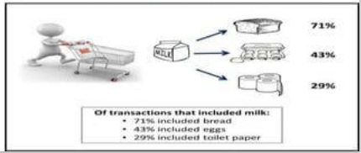
Association Rule
Association rule finds interesting associations and correlation relationships among large sets of data items.
Association rules show attribute value conditions that occur frequently together in a given data set.
A typical example of association rule mining is Market Basket Analysis.
What items are frequently bought together by customers?

Slide 32
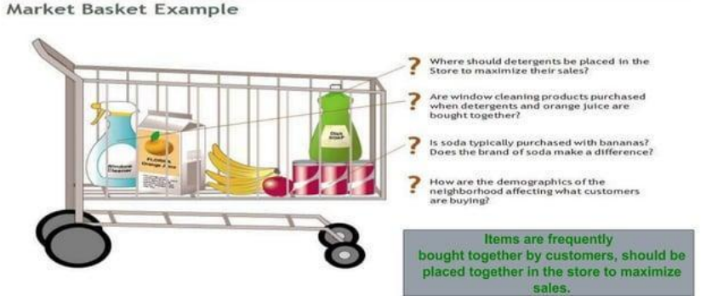
Example of Market Basket Analysis

Slide 33
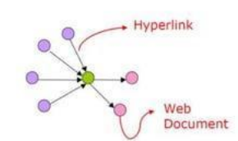
Web Structure Mining
The structure of a Web consists of Web pages as nodes, and hyperlinks as edges connecting between two related pages
Web structure mining is to study the relationship between the reference pages to find useful patterns, and improve search quality by analyzing the links between pages.
The research at the hyperlink level is also called hyperlink analysis.
Web structure mining focuses on
Reducing irrelevant search results
Help indexing information on the web

Slide 34
Web Structure Terminology
Web-Graph: A directed graph that represent the web.
Node: Each Web page is a node of the Web-graph.
Link: Each hyperlink on the Web is a directed edge of the Web-graph.
In-degree: The in-degree of a node, p is the number of distinct links that point to p.
Out-degree: The out-degree of a node, p is the number of distinct links originating at p that point to other nodes.

Slide 35

Web Structure Terminology
Directed Path: A sequence of links, starting from p that can be followed to reach q.
Shortest Path: Of all the paths between nodes p and q, which has the shortest length, i.e. number of links on it.
Diameter: The maximum of all the shortest paths between a pair of nodes p and q, for all pairs of nodes p and q in the Web-graph (the length of the longest shortest path)

Slide 36
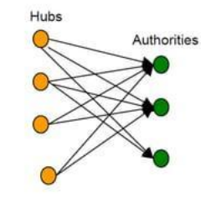
Hubs and Authorities
Hubs and authorities are ‘fans’ and ‘centers’ of a web graph
A good hub page is one that points to many good authority pages
A good authority page is one that is pointed to by many good hub pages

Slide 37
Social Network Mining

Slide 38
Social Media Mining
Social media mining is the process of representing, analyzing, and extracting actionable patterns and trends from raw social media data.
Social media mining uses a range of basic concepts from computer science, data mining, machine learning, and statistics.
Social media mining is based on theory from social network analysis(SNA)
Data mining techniques in social media mining are:
Graph mining
Text mining

Slide 39
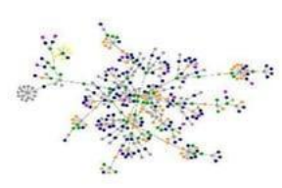
Social Network Analysis
Social network analysis [SNA] is the mapping and measuring of relationships and flows between people, groups, organizations, computers, and other connected information/knowledge entities.
The nodes in the network are the people and groups while the links show relationships or flows between the nodes.
SNA provides both a visual and a mathematical analysis of human relationships.
Example
Who knows whom and who shares what
information and knowledge with whom
through what media.

Slide 40
Graph Mining
Extracting useful knowledge (patterns, outliers, etc.) from structured data that can be represented as a graph
A graph is a set of nodes and the relationships that connect those nodes
Nodes and relationships contain properties to represent data.

Slide 41
Text Mining
A social network contains a lot of data in the nodes of various forms. For example, a social network may contain blogs, articles, messages, and etc.
Common application for text mining is to aid in the automatic classification of texts. For example, it is possible to "filter" out automatically most undesirable "junk email" based on certain terms or words that are not likely to appear in legitimate messages

Slide 42
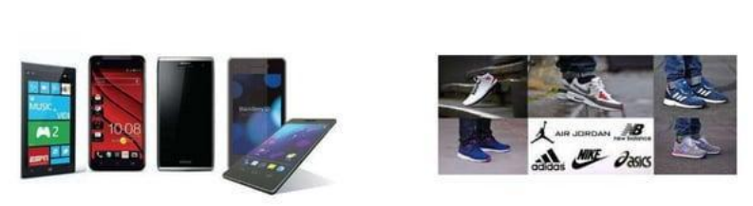
Excercise
Compare two competitive products in social media base on the comments on the products (use text mining tool-voyant)

Slide 43
Advice
Kindly read the book before and after the lecture, if some terms/ words are not covered in the lecture, if appear in exam it might not appear strange or out of course.

